Slide 1




RTES Engineering Solutions Weekly Update
August 19th, 2026

Slide 2
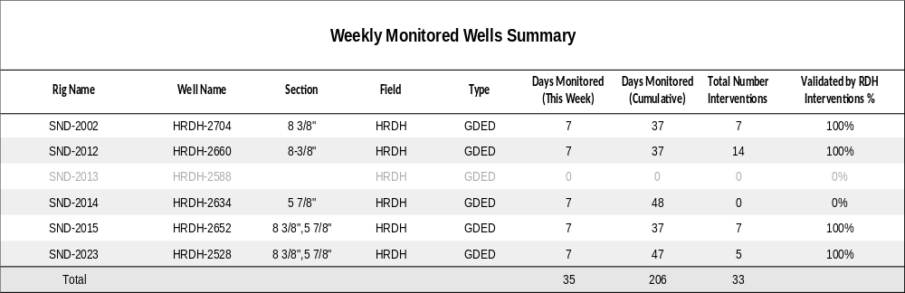
Wells Monitored

Slide 3
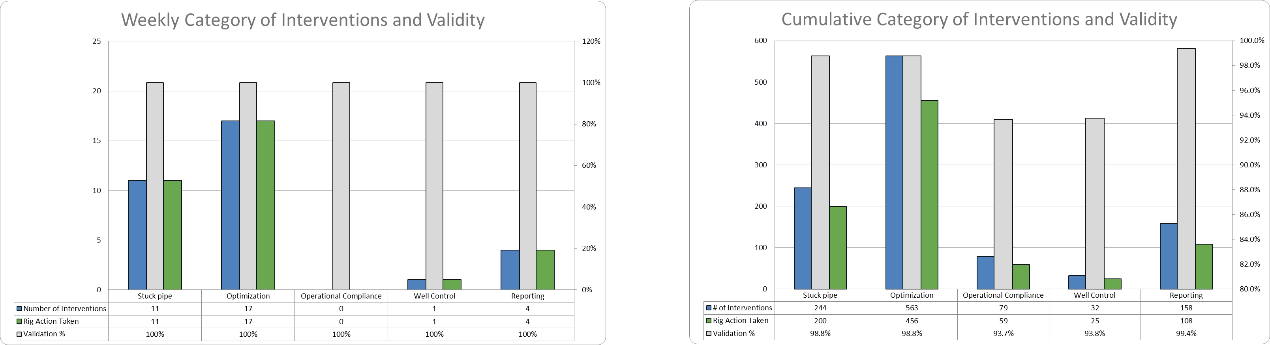
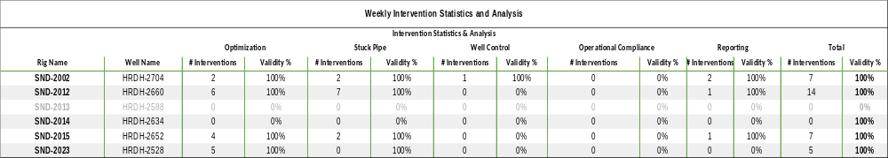
Weekly Interventions Summary
Cumulative Summary

Slide 4
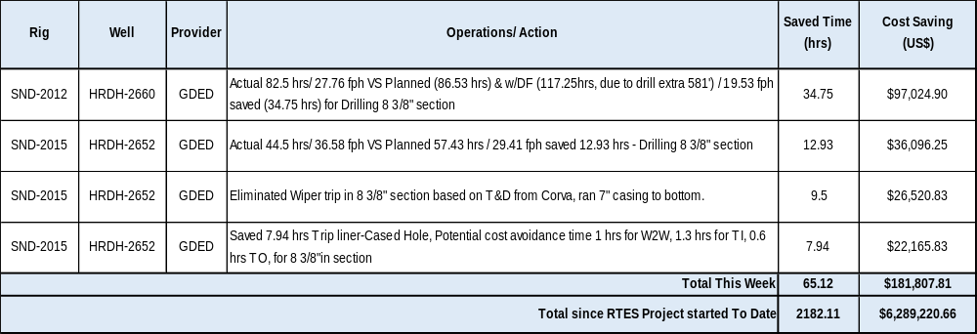
RTES realized Cost Saving in RDH Project: (from July 12th till August 18th 2026)

Slide 5
Use Cases

Slide 6
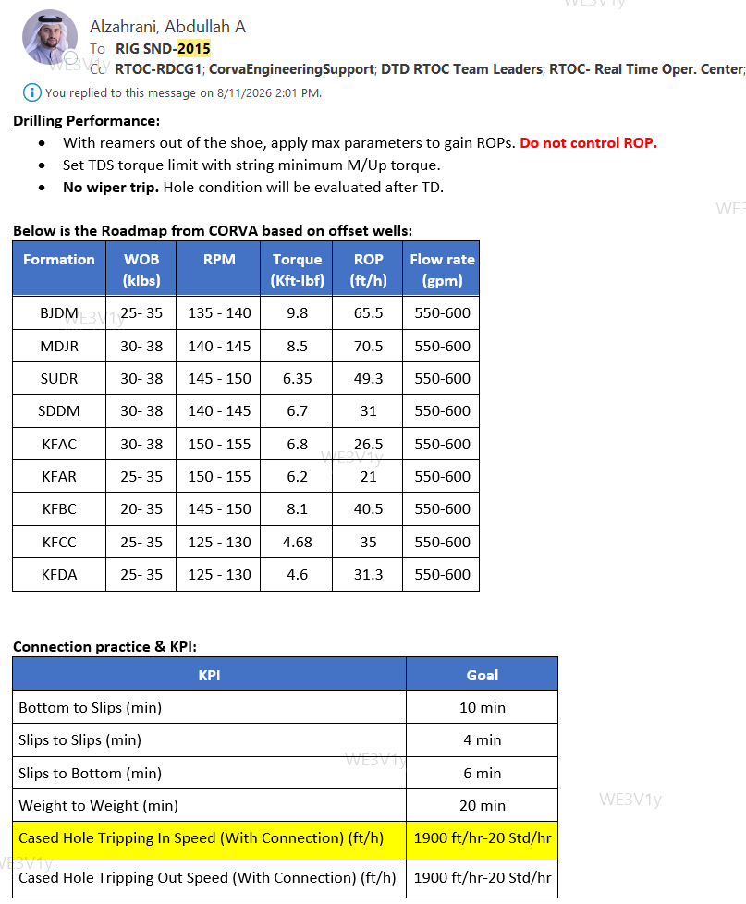
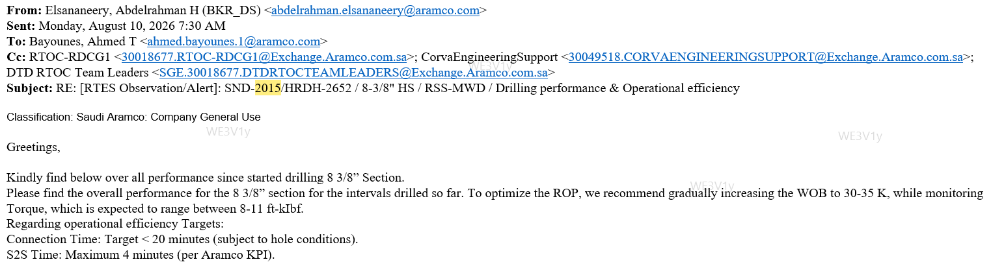
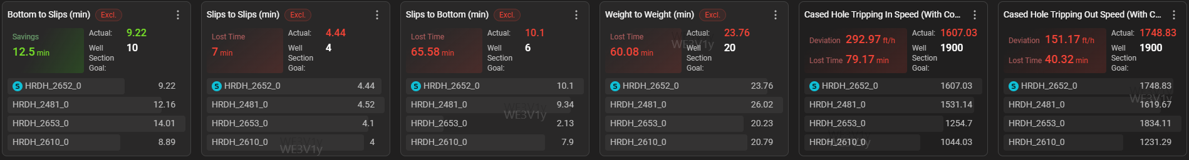
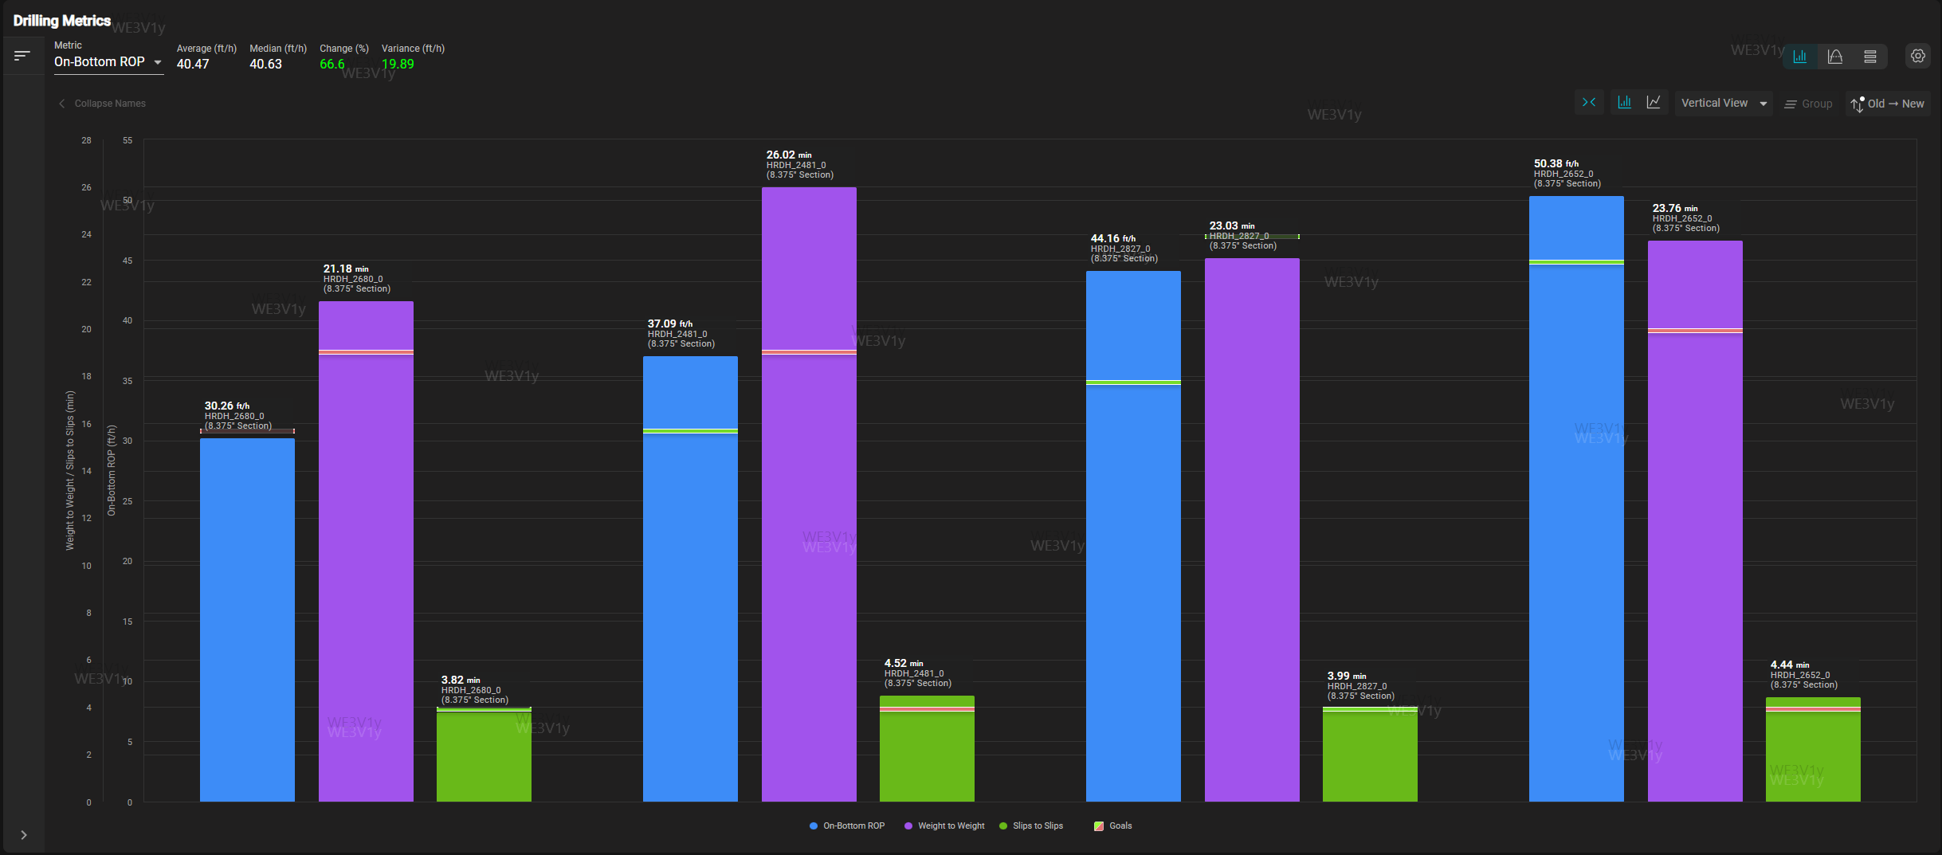
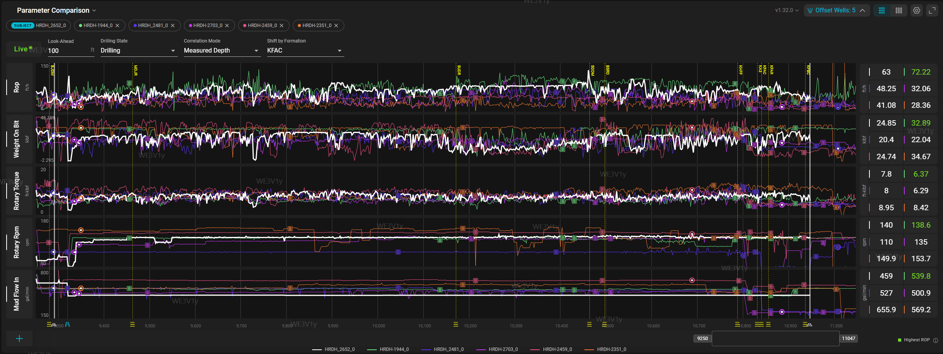
SND-2015 | HRDH-2652 | ROP Improvement 8 3/8” Hole Section
The 8 3/8" section was completed in 44.5 hrs , compared to the planned 57.43 hrs, resulting in a total saving 12.93 hr. Additionally, an ILT Potential cost avoidance of 2.9 hr for W2W time & tripping speed
None ADH
ADH
ADH
ADH

Slide 7
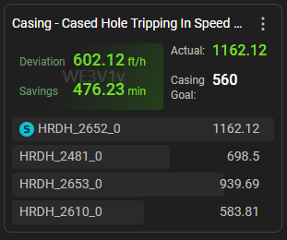
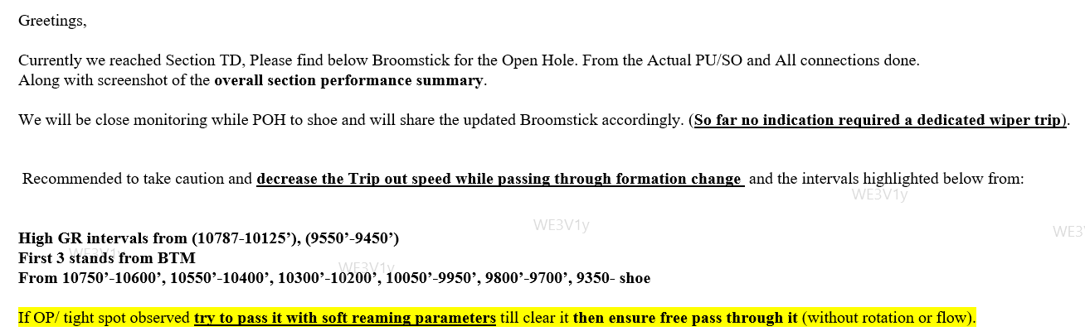
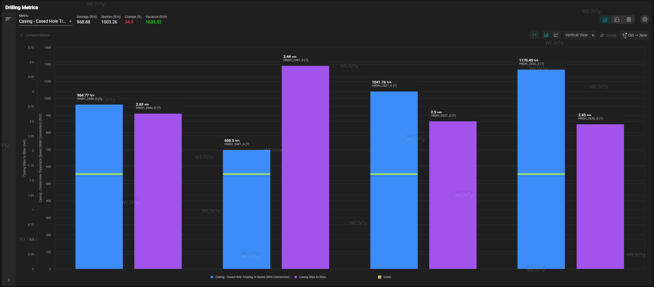
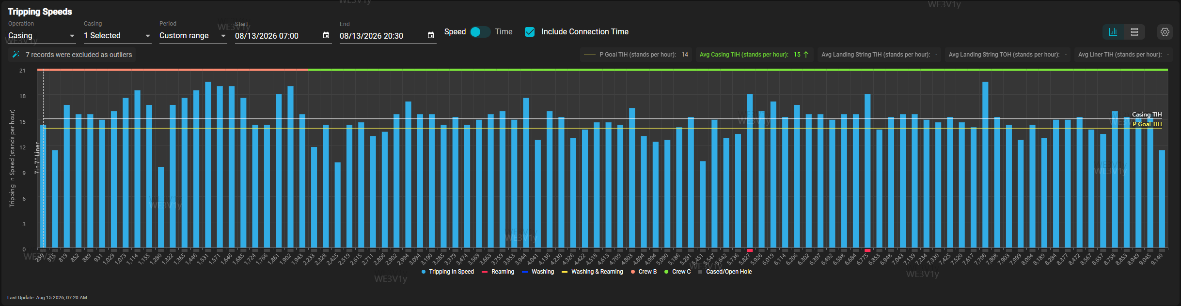
SND-2015 | HRDH-2652 | Wiper trip elimination
Liner Optimization: Eliminated 8 3/8" wiper trip and optimized 7" liner run, saving 9.5 hrs .
Tripping Efficiency: Improved casing-cased hole tripping speeds, resulting in a 7.94 hrs time saving.
Aramco KPI 14 Joint per hr
Achieved 15 Joint per hr
None ADH
ADH
ADH
ADH

Slide 8
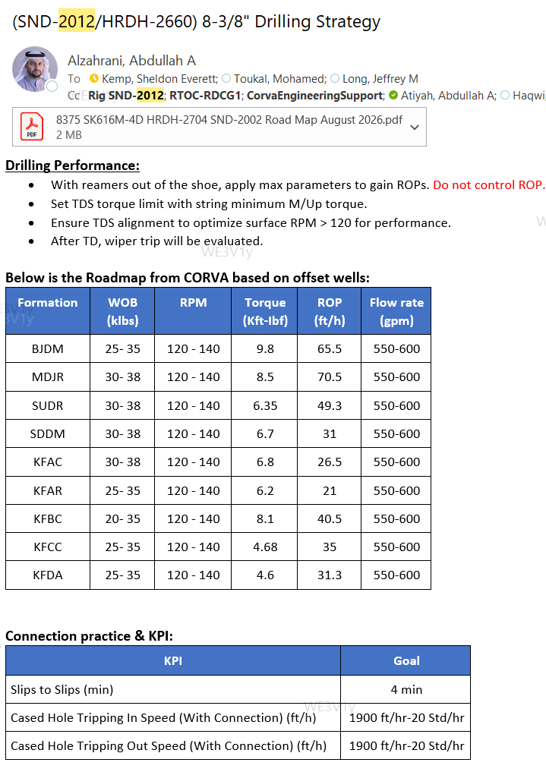
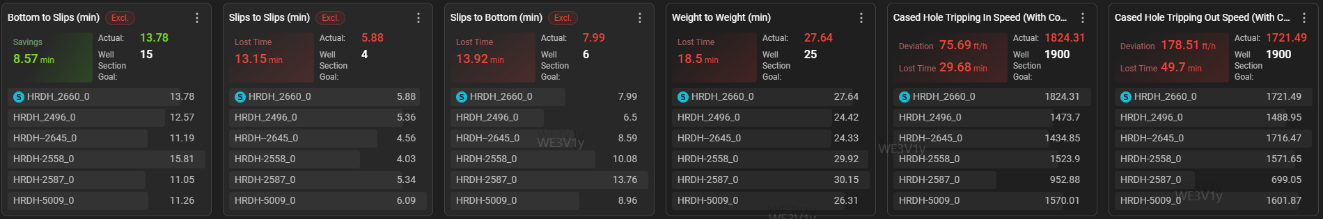
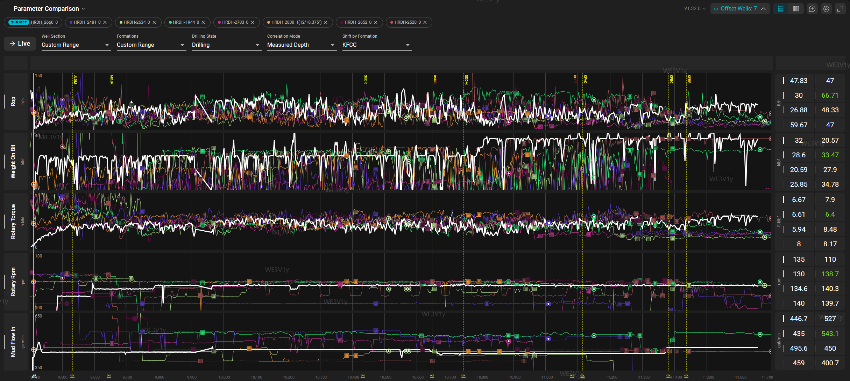
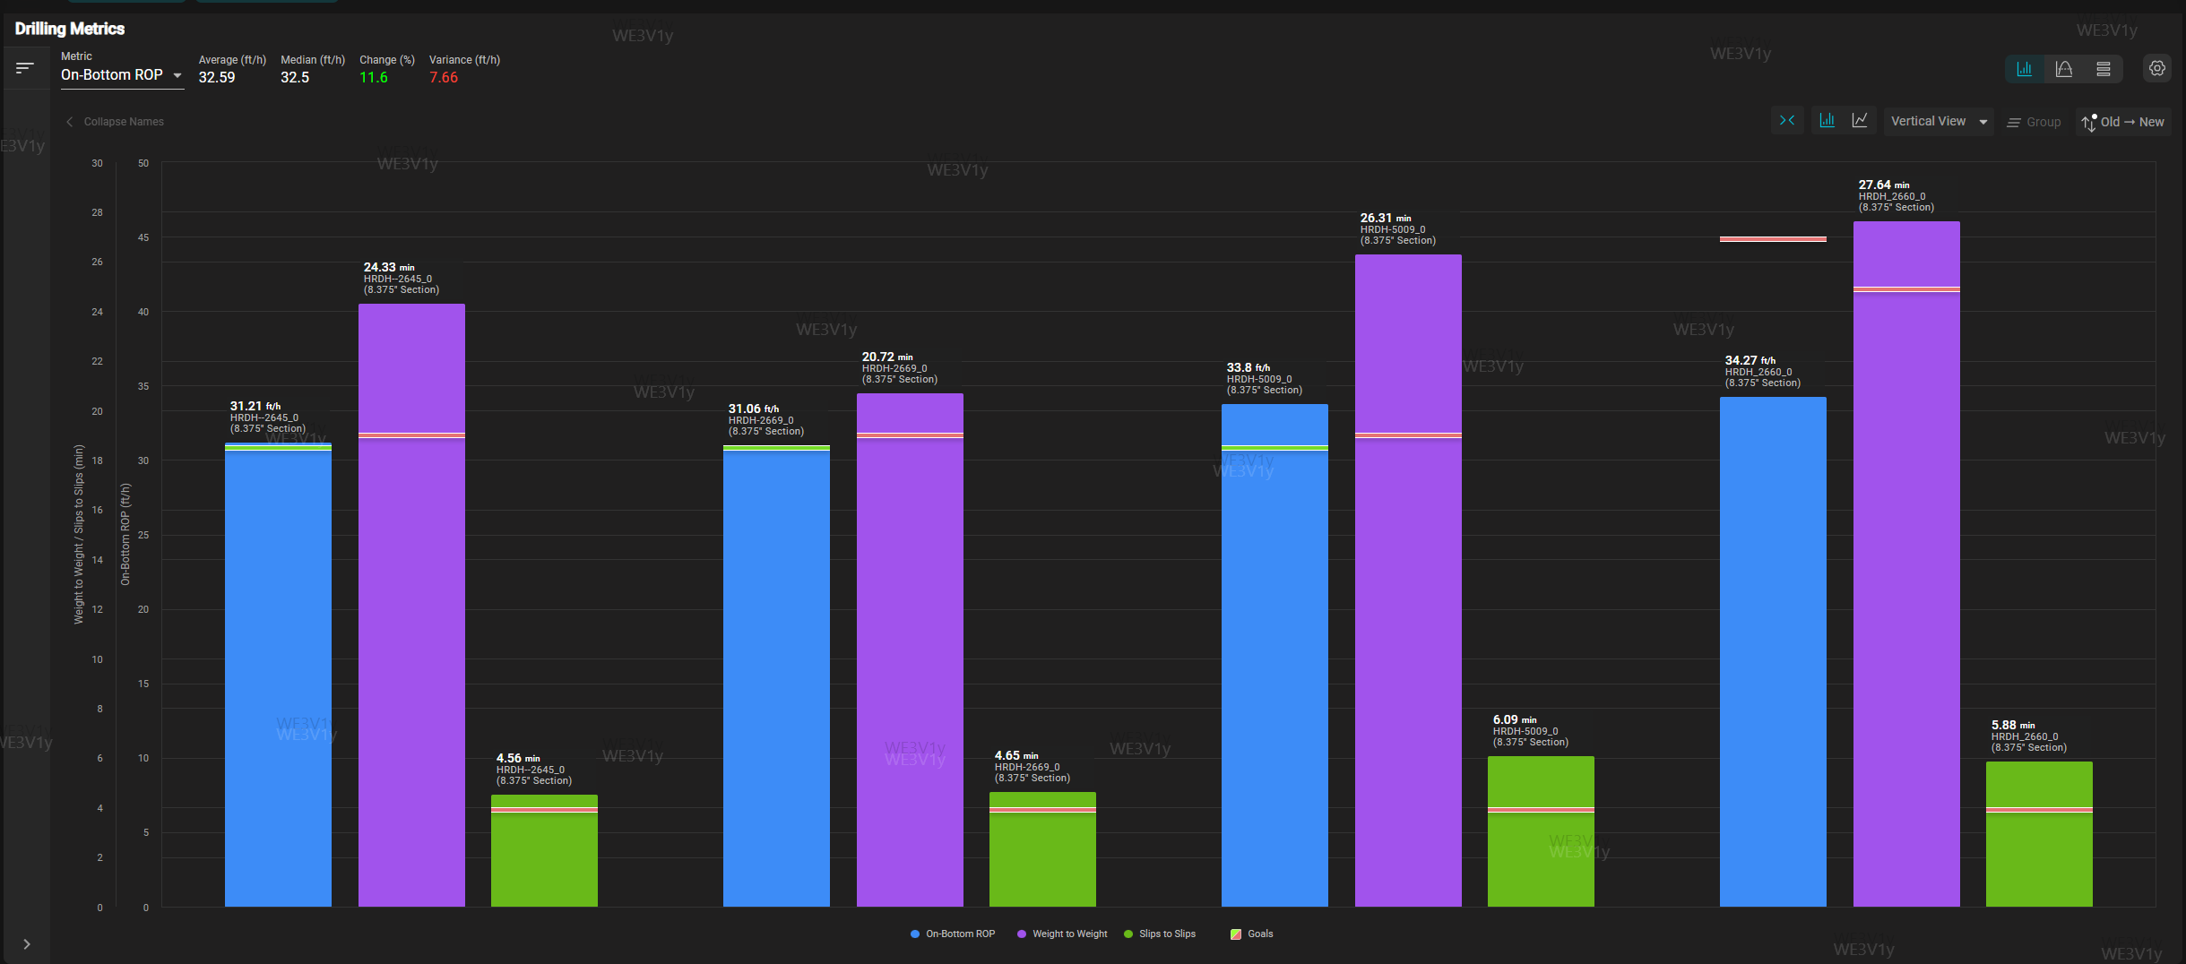
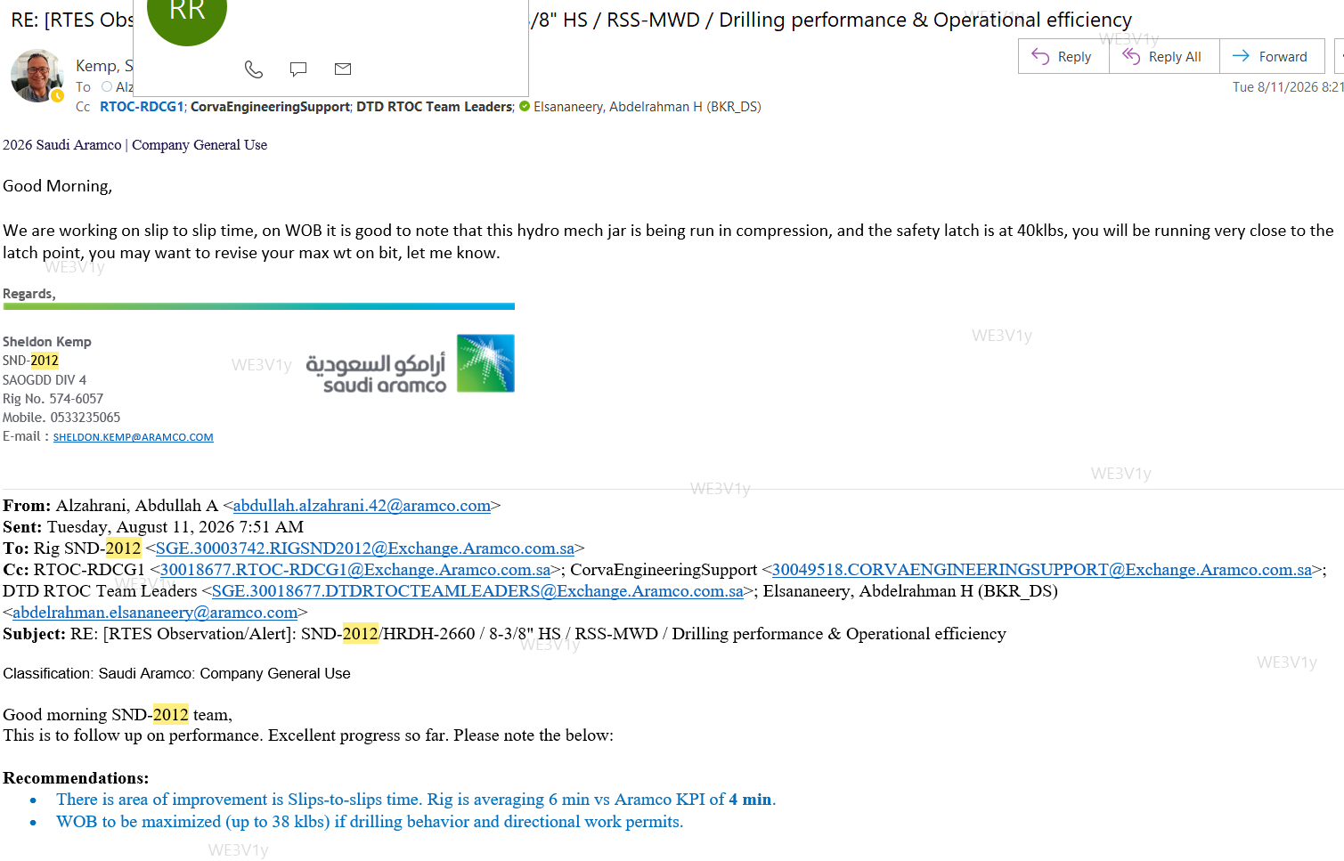
SND-2012 | HRDH-2660 | Drilling Performance 8 3/8” Hole Section
Drilling Efficiency: 8 3/8" section drilled 34.75 hrs faster than planned after applying drilling Factor(117.25hrs, due to drill extra 581') .
Operational Optimization: 2.9 hrs potential cost avoidance realized via improved W2W/S2S and tripping speeds within the casing.
None ADH
ADH
ADH
ADH
MPD

Slide 9
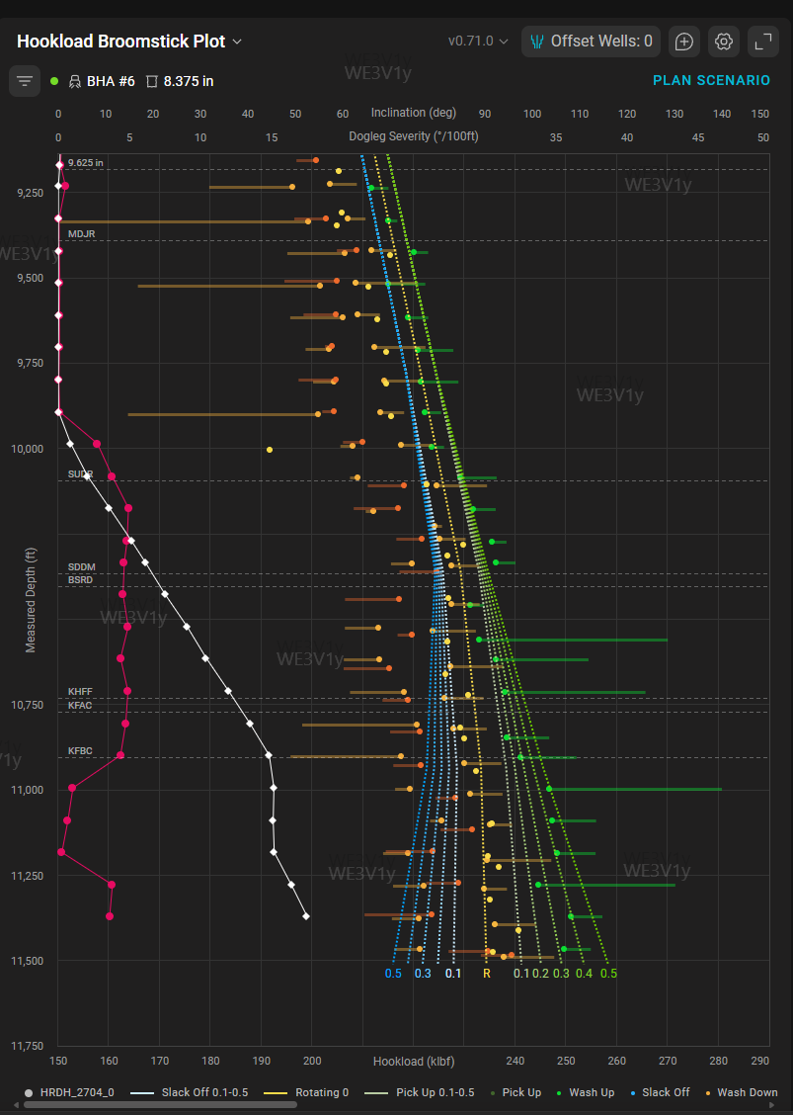
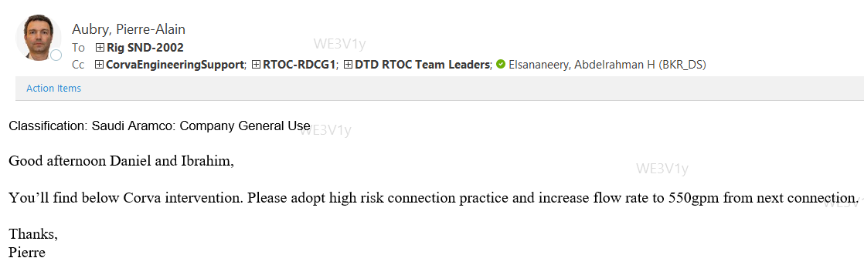
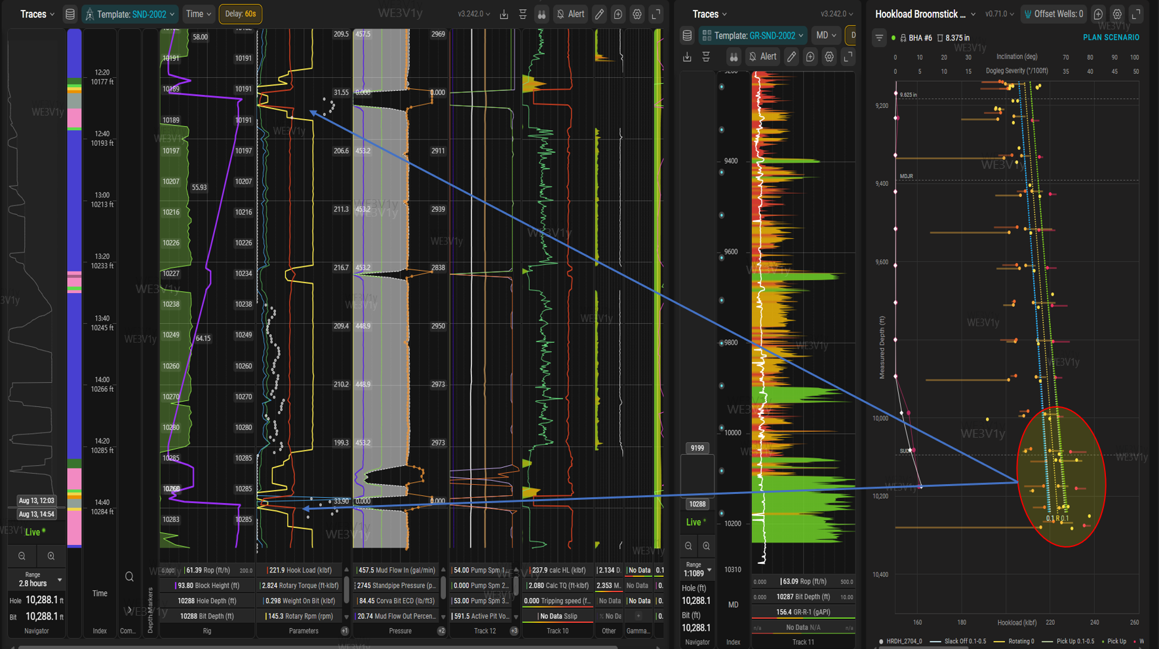
SND-2002 | HRDH-2705 | Hook load Broomstick
Observation: High Break-Out (BO) torque and Hook Load (HL) observed; increased PU weight friction.
Mitigation: Adopt high-risk connection practices and minimize stationary time.
Focus Area: High OB zones within KFA&B (Pre-set well).

Slide 10
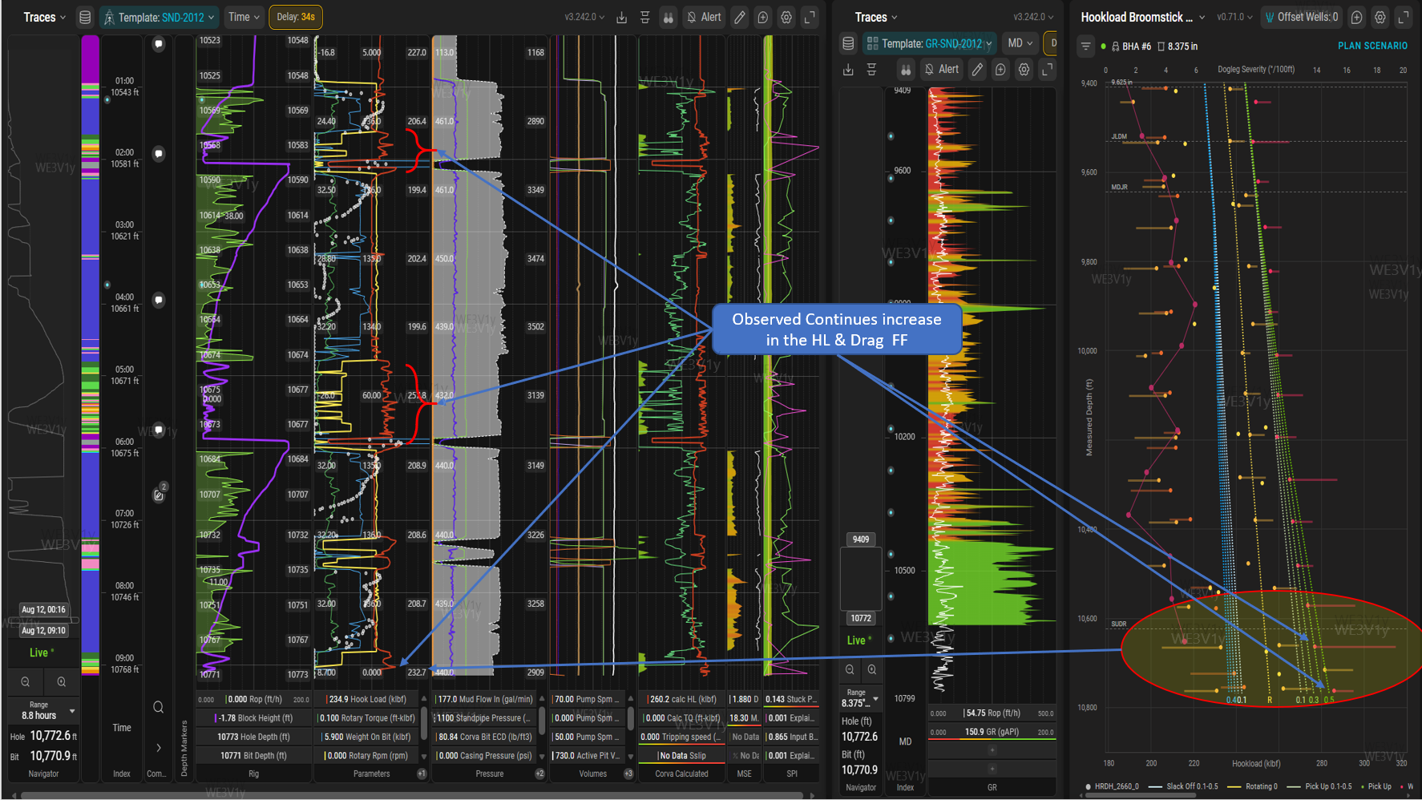
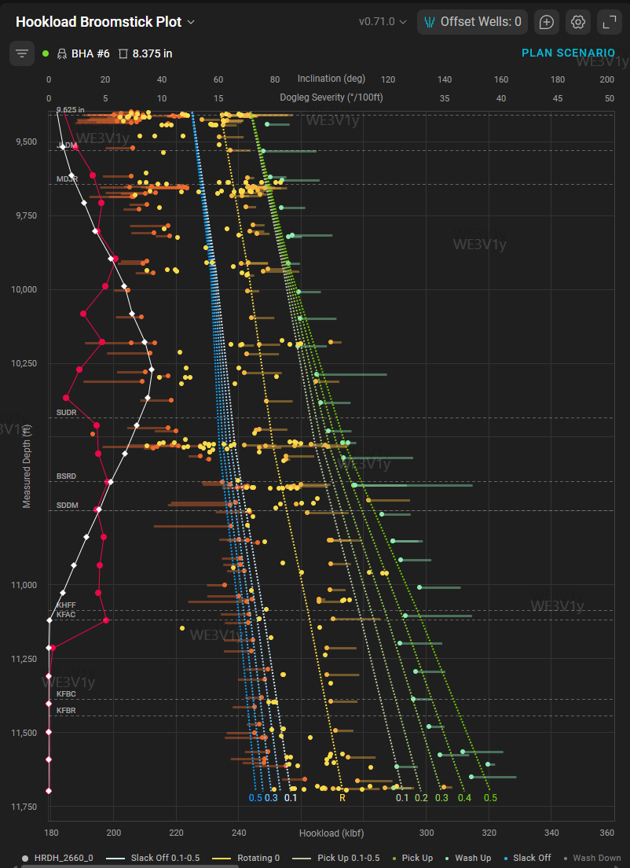
SND-2012 | HRDH-2660 | Hook load Broomstick
Observations: High Break-Out (BO) torque and Hook Load (HL) observed, with an increase in Pick-Up (PU) weight friction factors.
Recommendation: Implement high-risk connection practices and minimize stationary time.
Objective: Mitigate risks prior to entering high overbalance (OB) zones within the KFBR formation.

Slide 11
RT RDH Project Updates

Slide 12
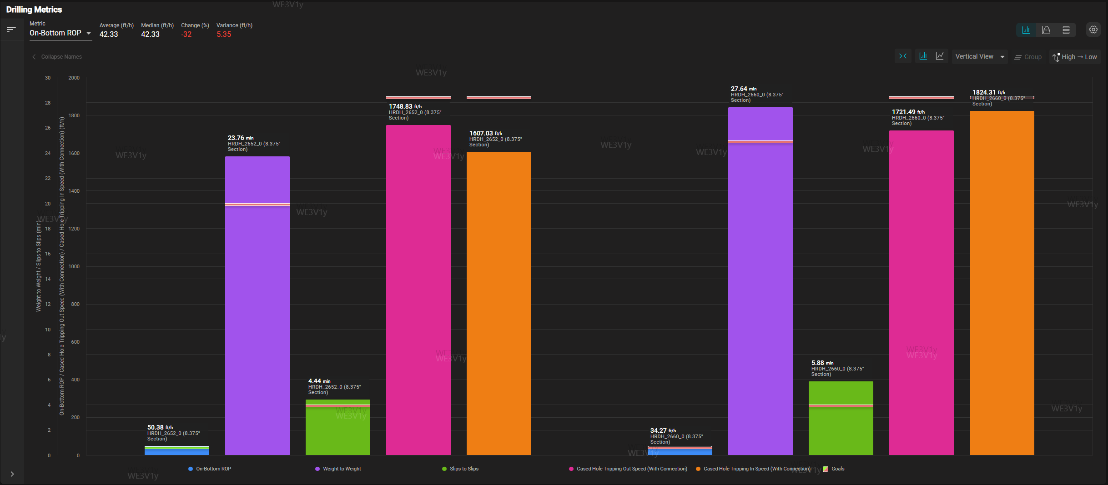
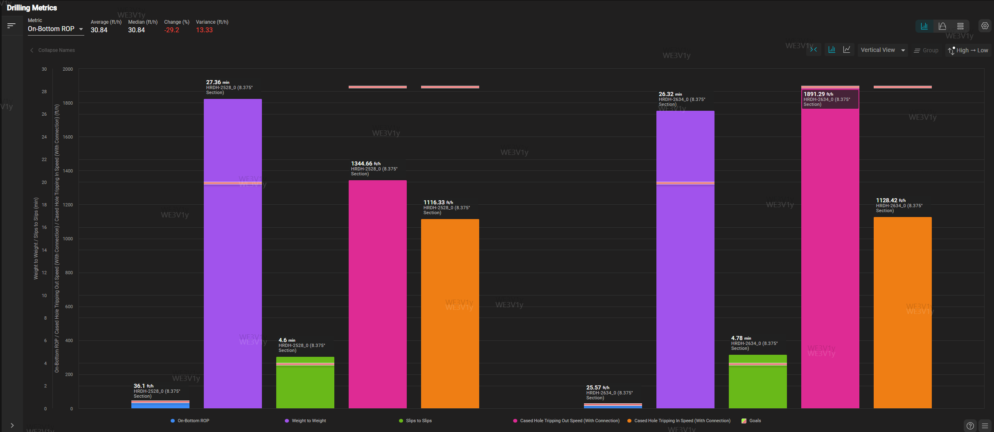
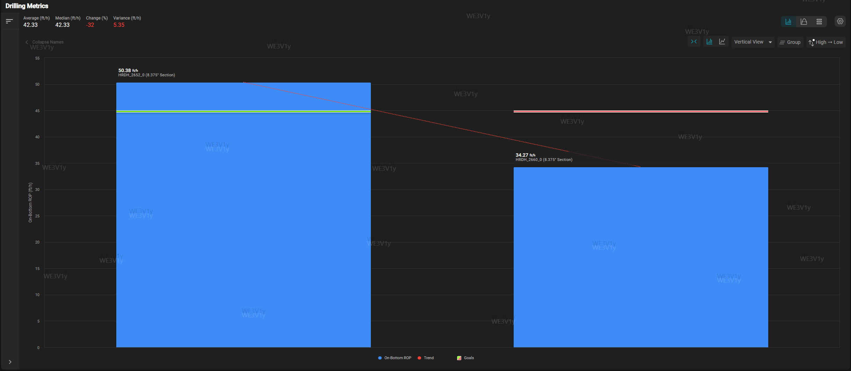
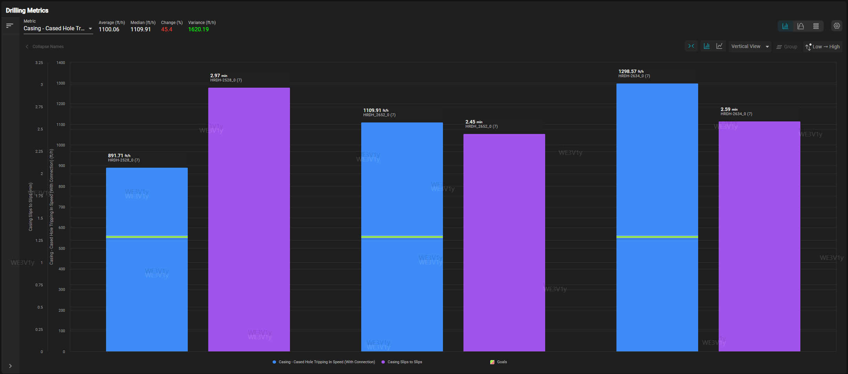
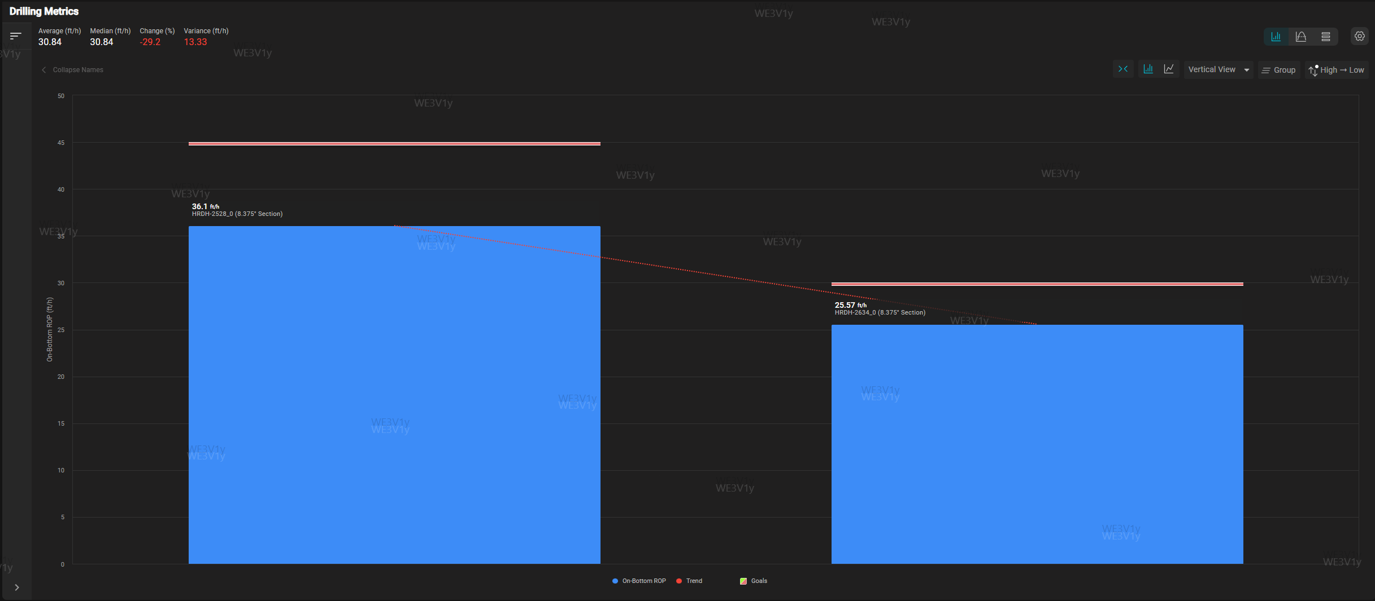
8 3/8 in section KPI Comparison for Active wells
8 3/8” MK-1 S-shape profile
SND-2015 & SND-2012
8 3/8” MK-1 Vertical profile
SND-2023 & SND-2014
MPD
MPD
On BTM ROP
7 in Liner TI speed & S2S
On BTM ROP
SND-2015
SND-2012
SND-2023
SND-2014
SND-2023
SND-2015
SND-2014

Slide 13
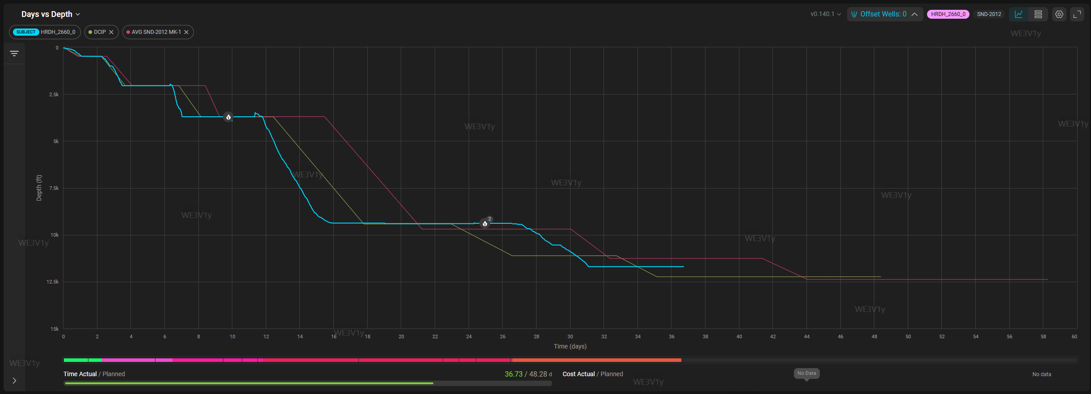
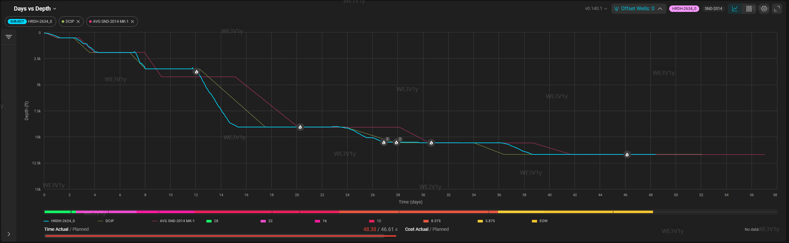
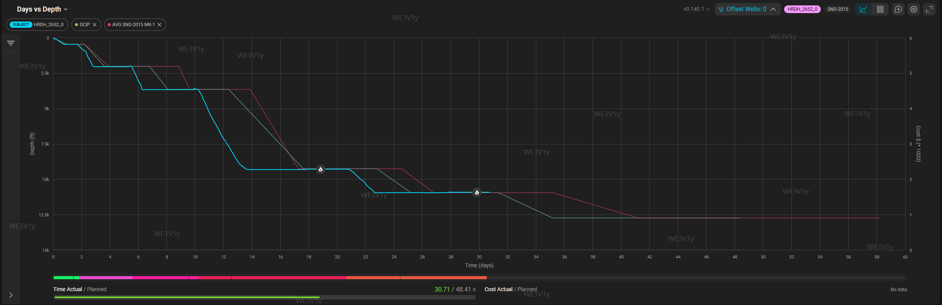
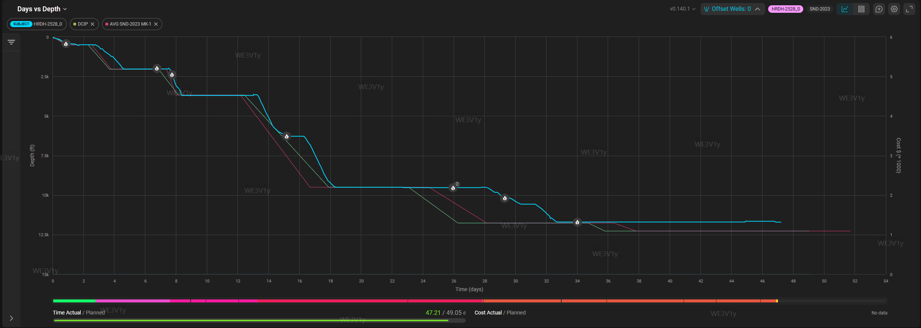
SND-2012 (HRDH-2660_0)(S-Shape MK-1 GP Targeting Khuff-C.)
SND-2014 (HRDH-2634_0 ): (MK-1, Vertical GP 250' INTO KFDA)
SND-2015 (HRDH-2652_0) : (S-Shape MK-1, PKGP with well TD at 150' into PUZU)
SND-2023 (HRDH-2528_0): (MK-1, Vertical GP 250' INTO KFDA)

Slide 14
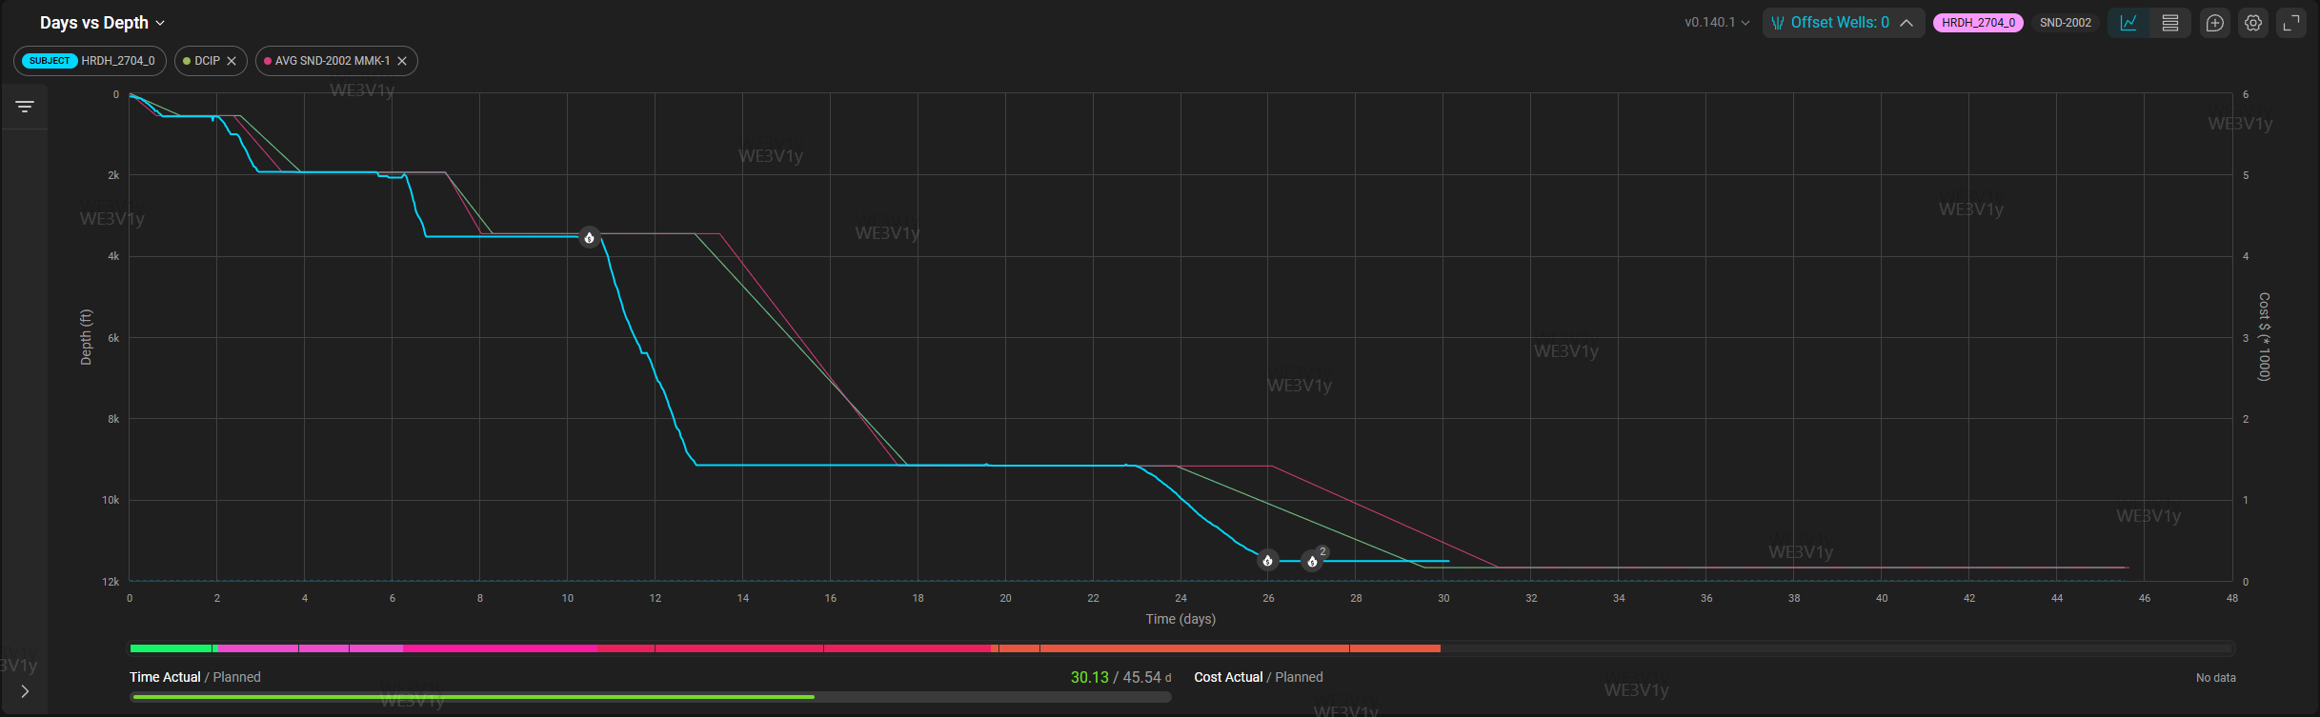
SND-2002 (HRDH-2704):( MMK-1 Pre-set well targeting KHUFF-C Reservoir)

Slide 15
Action Items

Slide 16
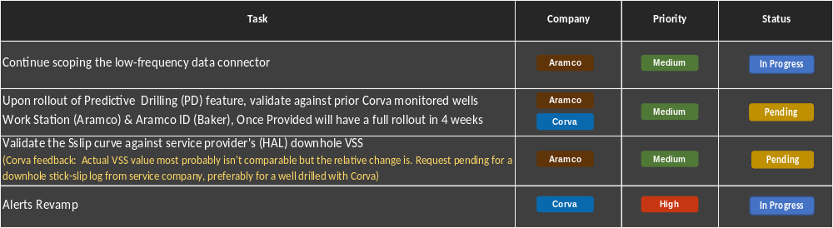
Action Items

